Slide 1



DocuMind AI
Hybrid RAG-Based Knowledge Assistant
Guided by
Sneh Lata Singh
Presented by
Abhay Maurya • Amit Yadav • Varun Rana • Shanu Ahmed • Samir Ahmad

Slide 2




Era of Document Intelligence
The AI Transformation
Cognitive Assistance
Large Language Models (LLMs) have revolutionized how we interact with unstructured data, turning static documents into interactive knowledge bases.
DocuMind AI bridges the gap between massive document repositories and instant, contextual insights using advanced Retrieval-Augmented Generation.

Slide 3
The Privacy & Context Gap
shield
signal_wifi_off
psychology_alt
Cloud Privacy
Connectivity
Hallucination
Uploading sensitive corporate or personal data to public cloud AI models poses significant security risks and compliance issues.
Most AI assistants fail without high-speed internet, making them unusable in air-gapped or low-connectivity environments.
LLMs without RAG often hallucinate facts when asked specific questions about niche or private documents not in their training data.

Slide 4


Motivation Behind DocuMind
Sovereignty: Demand for data sovereignty in legal and medical sectors.
Efficiency: Reducing "search time" by 70% in large document audits.
Hybrid Need: Bridging the gap between Local LLM privacy and Cloud LLM power.
Academic Value: Creating a standardized framework for offline-first RAG.

Slide 5

Hybrid RAG Architecture
Secure, Intelligent, Offline-Ready
DocuMind AI is a dual-engine RAG assistant. It routes queries based on user preference and data sensitivity.
By leveraging FAISS for local vector storage and a Smart Router, it offers the best of both worlds: extreme privacy when offline and superior intelligence when online.

Slide 6

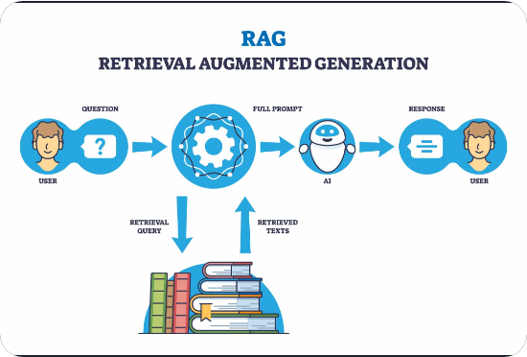
Retrieval Augmented Generation
Retrieval: Finding the needle in the haystack (relevant document chunks).
Augmentation: Providing retrieved context as a prompt prefix.
Generation: LLM produces an answer grounded in the actual facts.
Accuracy: Dramatically reduces hallucinations.

Slide 7


The Hybrid Advantage
Offline Mode
Online Mode
Uses Ollama or Llama.cpp to run models like Mistral or Llama3 locally. Zero bytes leave your machine.
Connects to OpenAI GPT-4 or Google Gemini via API for complex reasoning and deep summaries.
Best for: Confidential legal docs, medical records.
Best for: General knowledge synthesis, complex code analysis.

Slide 8

End-to-End System Journey
cloud_upload
Upload
Multi-format ingestion (PDF, DOCX)
memory
Vectorize
Semantic Embedding Generation
manage_search
Retrieve
FAISS Similarity Search
forum
Respond
Grounded LLM Generation

Slide 9
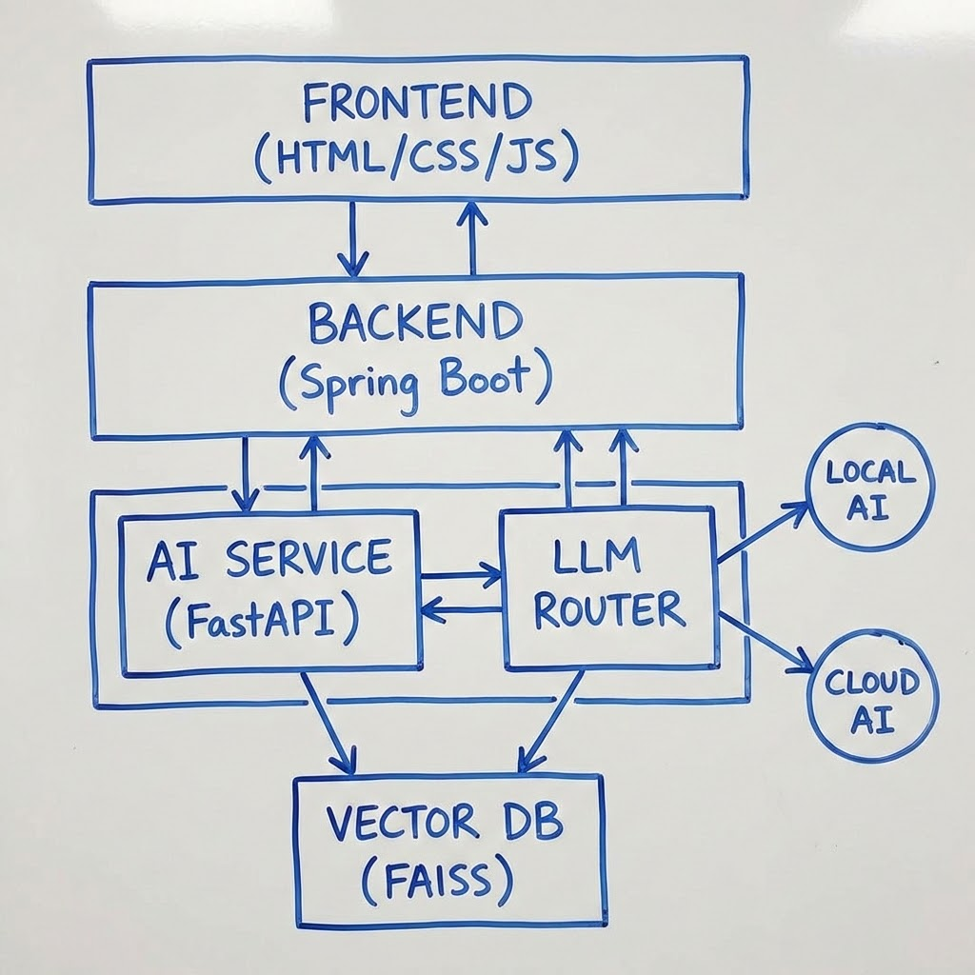
Technical Architecture Overview
Modular Component Stack
settings_input_component
Spring Boot: Orchestration, Auth, File Management.
bolt
FastAPI: AI Inference and Embedding Service.
storage
Vector DB: FAISS for high-speed indexing.
router
LLM Router: Logic to switch between Local & Cloud.

Slide 10
Data Ingestion Flow
cloud_upload
content_cut
auto_awesome
storage
Ingest
Chunk
Embed
Index
Multipart File Upload for high-volume data handling
Recursive Character Split to optimize context
Sentence-Transformers (Local) for vectorizing
FAISS FlatL2/HNSW for efficient search

Slide 11

Workflow: Document Ingestion
01
02
03
04
PDF Upload
Extraction
Indexing
Metadata
Spring Boot API handles binary data and secures file storage.
FastAPI & PyMuPDF perform high-fidelity text extraction.
Vectors stored in FAISS binary files for efficient search.
MySQL manages relations between users and documents.

Slide 12

Workflow: User Querying
terminal
search
alt_route
question_answer
01
02
03
04
Prompt
Search
Routing
Answer
User enters natural language question
Retrieve context from FAISS vector storage
LLM selection based on Local or Cloud constraints
Final response generated with source citations

Slide 13
The Technology Stack
Layer | Technology Used | Role
Frontend | HTML, CSS, JS | Modern SaaS Dashboard UI
Backend | Spring Boot / Java 17 | User Auth, APIs, DB Management
AI Microservice | Python / FastAPI | RAG Pipeline, Embeddings, LLMs
Database | MySQL + FAISS | Relational Data + Vector Storage
AI Models | OpenAI / Ollama / Llama3 | Online & Offline Generative AI

Slide 14
Core System Modules
Auth Module: Secure login with JWT.
Retrieval Engine: K-Nearest Neighbor search.
Parser Module: LangChain-based text extraction.
Inference Router: API/Local LLM gateway.
Embedding Engine: HuggingFace models for vectors.
UI Dashboard: Responsive React/SaaS interface.

Slide 15

Document Parsing & Chunking
Cleaning Stage
Semantic Chunking
Removal of boilerplate text, extra whitespaces, and metadata cleaning to ensure pure semantic content.
Overlap-based chunking (e.g., 500 chars with 50 overlap) to preserve context between adjacent text blocks.

Slide 16
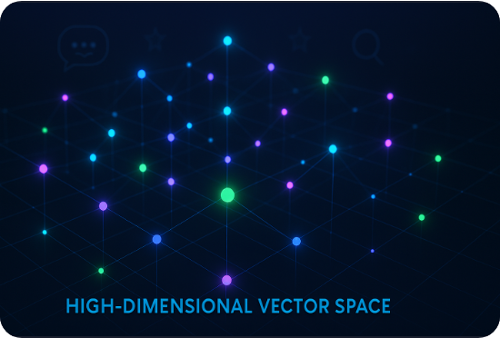

Vectorization & Storage
We use Cosine Similarity to determine relevance:
FAISS stores these as high-dimensional floats (384/768 dims) for sub-millisecond search.

Slide 17
The Retrieval Engine
Top-K Retrieval: Selecting the top 3-5 most relevant text segments.
Re-ranking: (Optional) Refining results based on secondary cross-encoders.
Context Stitching: Formatting chunks into a coherent block for the prompt.
Source Attribution: Tracking page numbers and filenames for citations.

Slide 18


The LLM Smart Router
Reliability Score
Decision Logic
99%
The intelligent routing engine evaluates:
Network Availability & Latency
Document Classification (Sensitive vs Public)
Task Complexity & Token Requirements
The router ensures near-perfect uptime by intelligently switching between edge and cloud resources based on environment constraints.
dns
cloud
Llama-3-8B
GPT-4o
Offline & Sensitive routing to Local compute.
Online & Authorized hits via Cloud API.

Slide 19






Platform Features
Private Mode
Source Citation
Multi-User
Total offline processing for ultimate data privacy.
Verifiable answers with links to document pages.
User-isolated document workspaces.

Slide 20
Project Advantages
Zero Cost (Offline): Local models consume no API credits.
High Reliability: Works during internet outages.
Scalability: Modular backend allows adding more LLMs easily.
Contextual Power: RAG grounding eliminates generic AI filler.

Slide 21
Current Limitations
Hardware Dependency: Local models require 8GB+ RAM.
Cold Starts: Local model loading can take 5-10 seconds.
Complex Formatting: Scanned PDFs require OCR (Future scope).

Slide 22
The Roadmap Ahead
Multimodal Support
Edge Deployment
Expanding to images, audio transcripts, and video content analysis using Vision-RAG.
Optimizing for mobile devices using TensorFlow Lite or MLC-LLM for true portability.

Slide 23


Research Foundation
Key Literature and Theoretical Insights

Slide 24
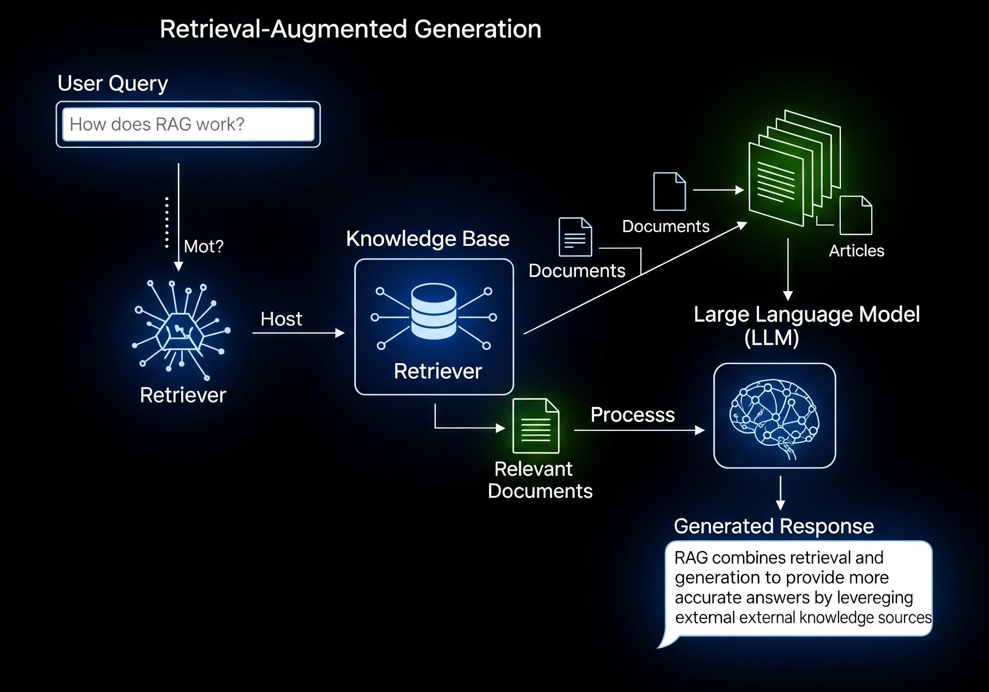

Paper 1: RAG Architecture
Lewis et al. (FAIR)
TITLE: Retrieval-Augmented Generation for Knowledge-Intensive NLP Tasks.
KEY INSIGHT: Proved that parametric (LLM) and non-parametric (Docs) memory combined outperform standalone LLMs.
RELATION: Forms the core theoretical base of DocuMind.
RAG SYSTEM WORKFLOW OVERVIEW

Slide 25

Paper 2: Dense Retrieval
Karpukhin et al.
Official Publication:
"Dense Passage Retrieval (DPR) for Open-Domain QA"
Key Insight
Dense embeddings outperform sparse (TF-IDF) methods by capturing latent semantic meaning.
Project Impact
Guided our choice of Sentence-Transformers for embedding generation within DocuMind.
HIGH-DIMENSIONAL VECTOR SPACE REPRESENTATION

Slide 26


Paper 3: FAISS Efficiency
Johnson et al.
Title
"Billion-scale similarity search with GPUs"
Key Insight
Optimized algorithms (HNSW, IVF-Flat) for sub-linear search time in high dimensions.
Relation
Selected FAISS as our vector storage engine to ensure peak performance for DocuMind.
Vector Indexing & GPU Acceleration

Slide 27
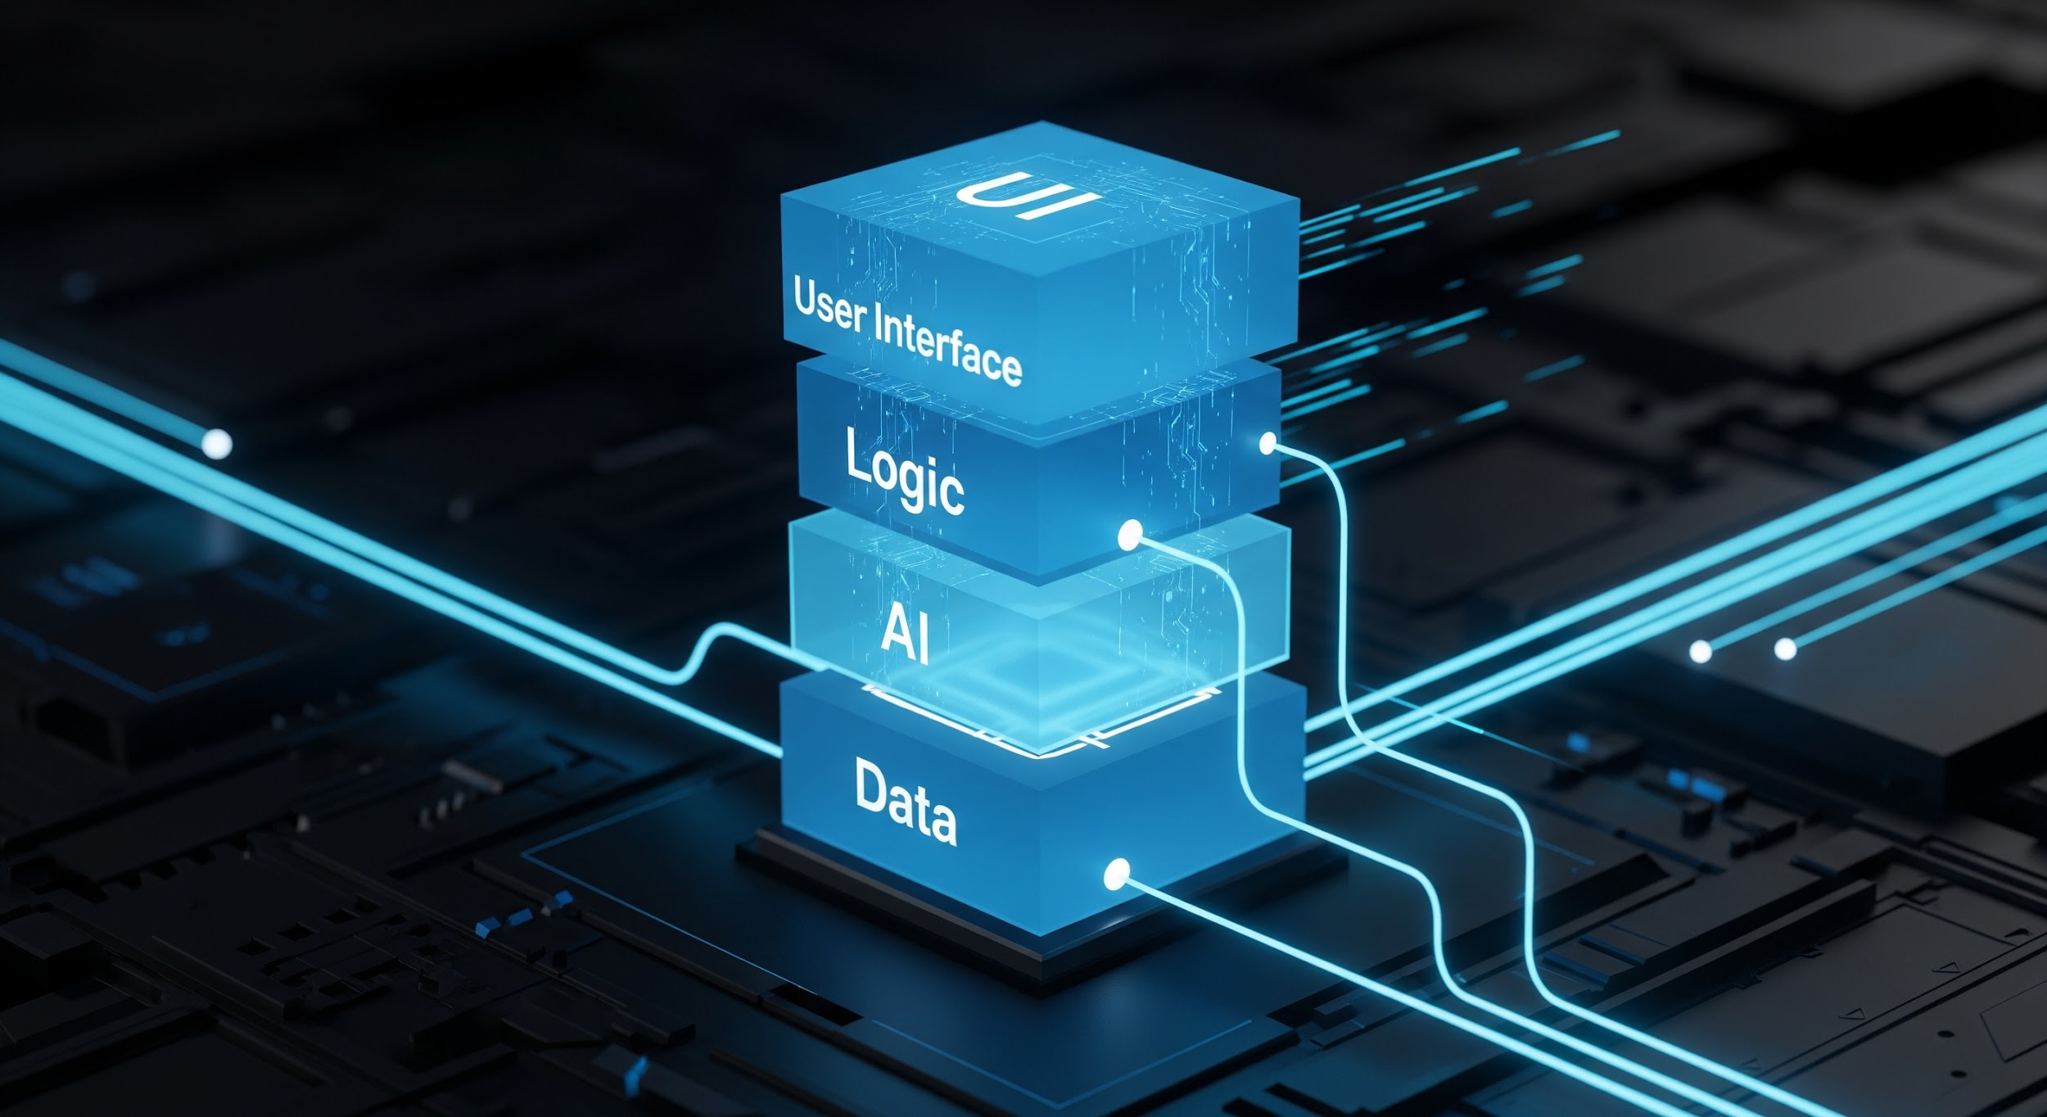
Paper 4: LLM System Architecture
Project Implementation Stack
Functional Software Reference Architecture
UI / Frontend
HTML / CSS / JS
Backend Logic
Spring Boot
Architecture Pillars
Modular design for maintainability
Scalable & secure infrastructure
API-first integration patterns
AI Integration
FastAPI + LLM
Data Layer
FAISS Vector DB
Insight
"LLM systems must be treated as modular software applications, not just standalone models."

Slide 28


Paper 5: Edge AI Computing
Han et al.
Official Title
"Efficient Transformers on Edge Devices."
Key Insight
Model quantization (Int4/Int8) allows large models to run on consumer-grade hardware.
Project Relation
Validates our offline support using quantized Llama3 models for local execution.
Optimized Edge Architecture

Slide 29






Literature Key Insights
Grounding
Vector Power
Local First
Retrieval is essential to ground models and avoid factual errors.
Dense search is the gold standard for semantic document understanding.
The future of AI lies in "Private by Design" local execution.

Slide 30

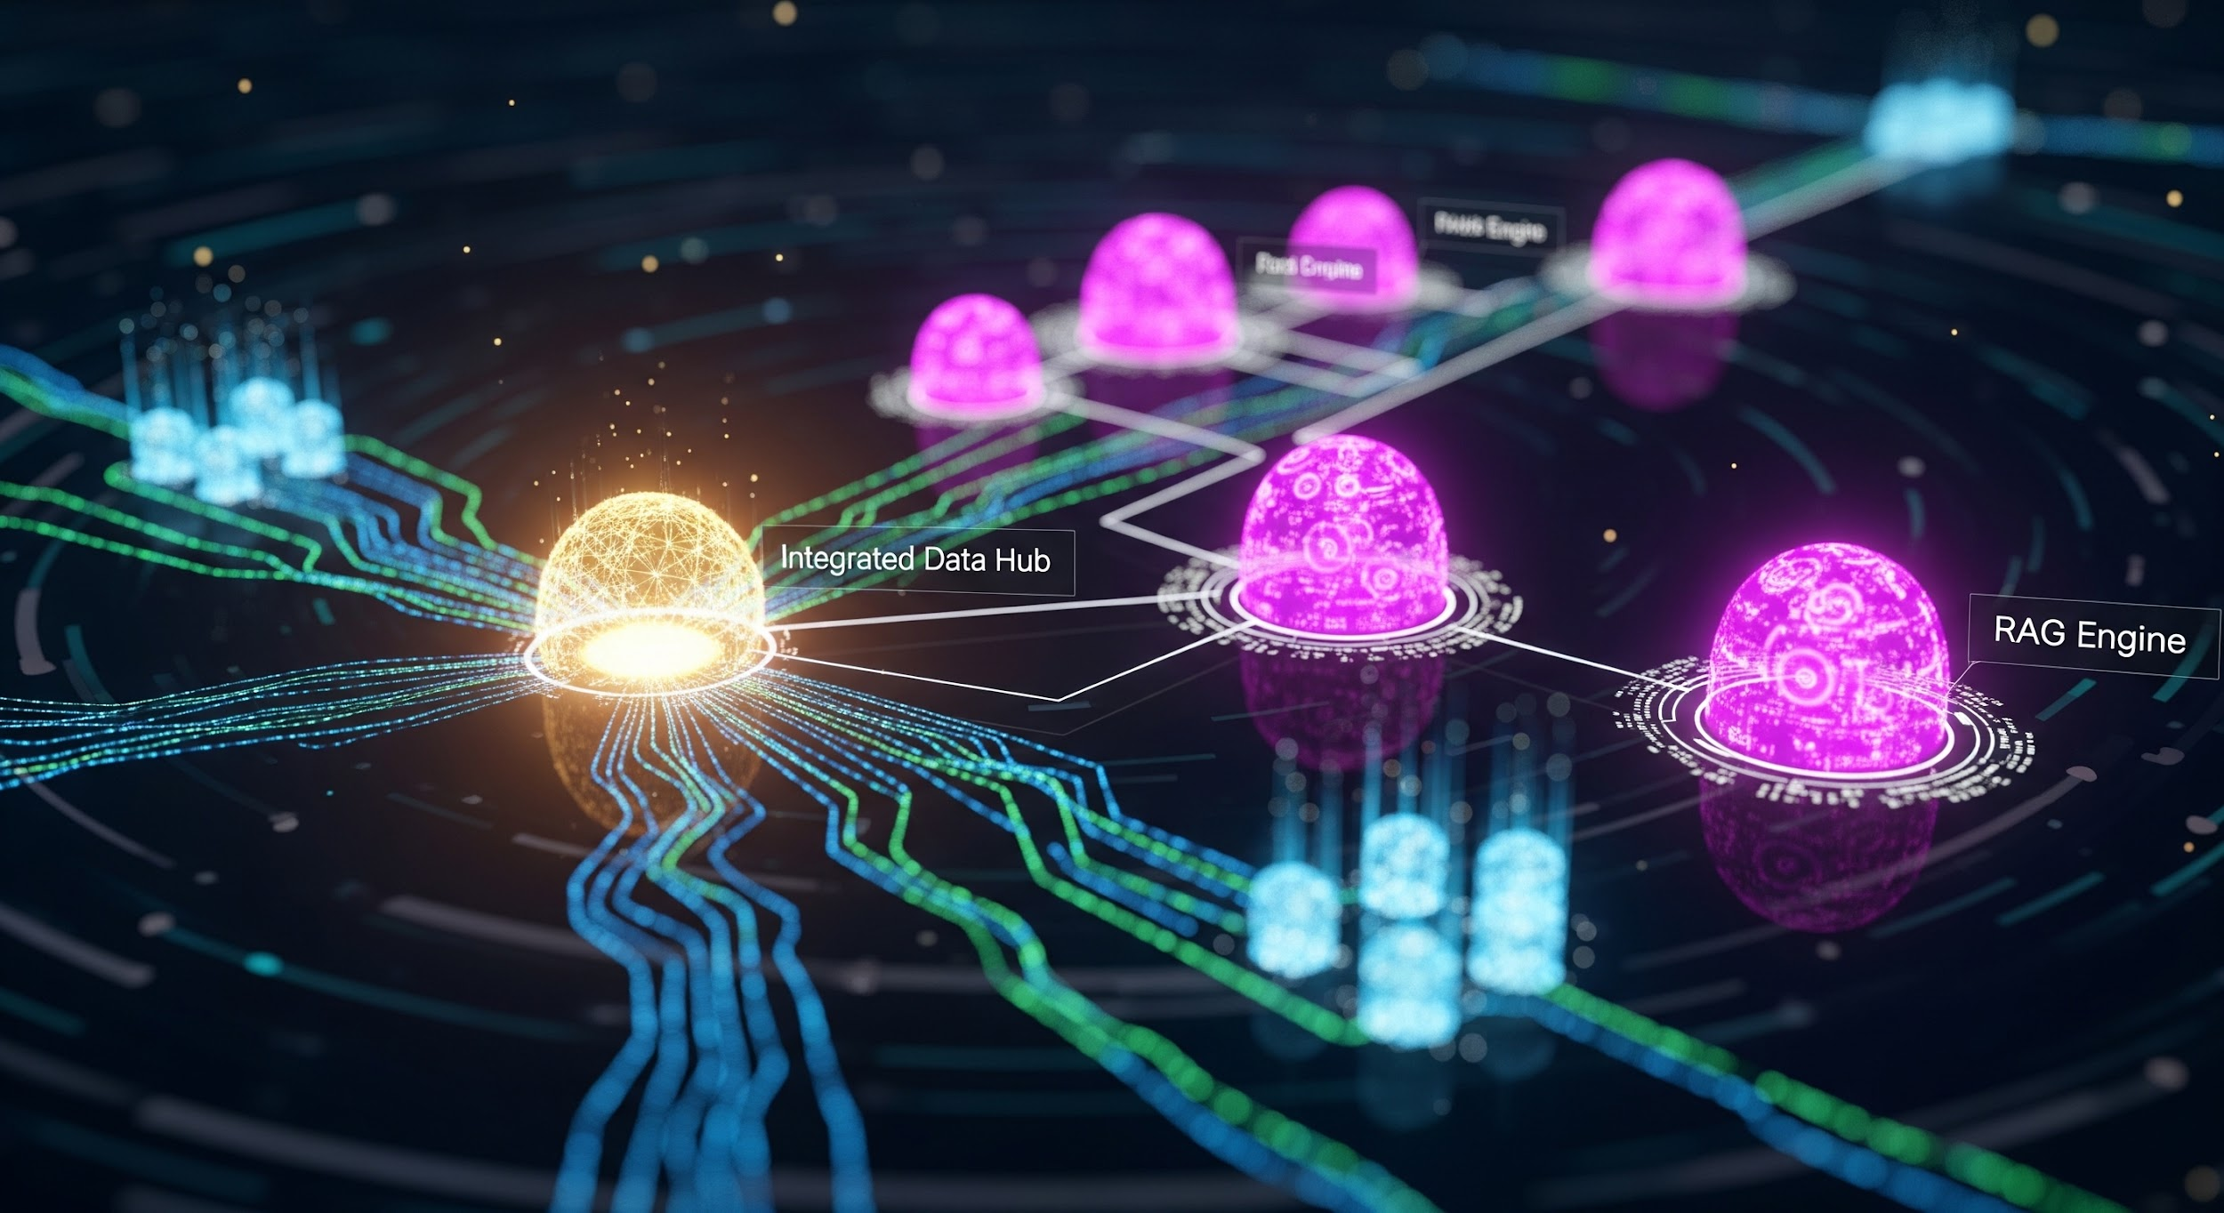
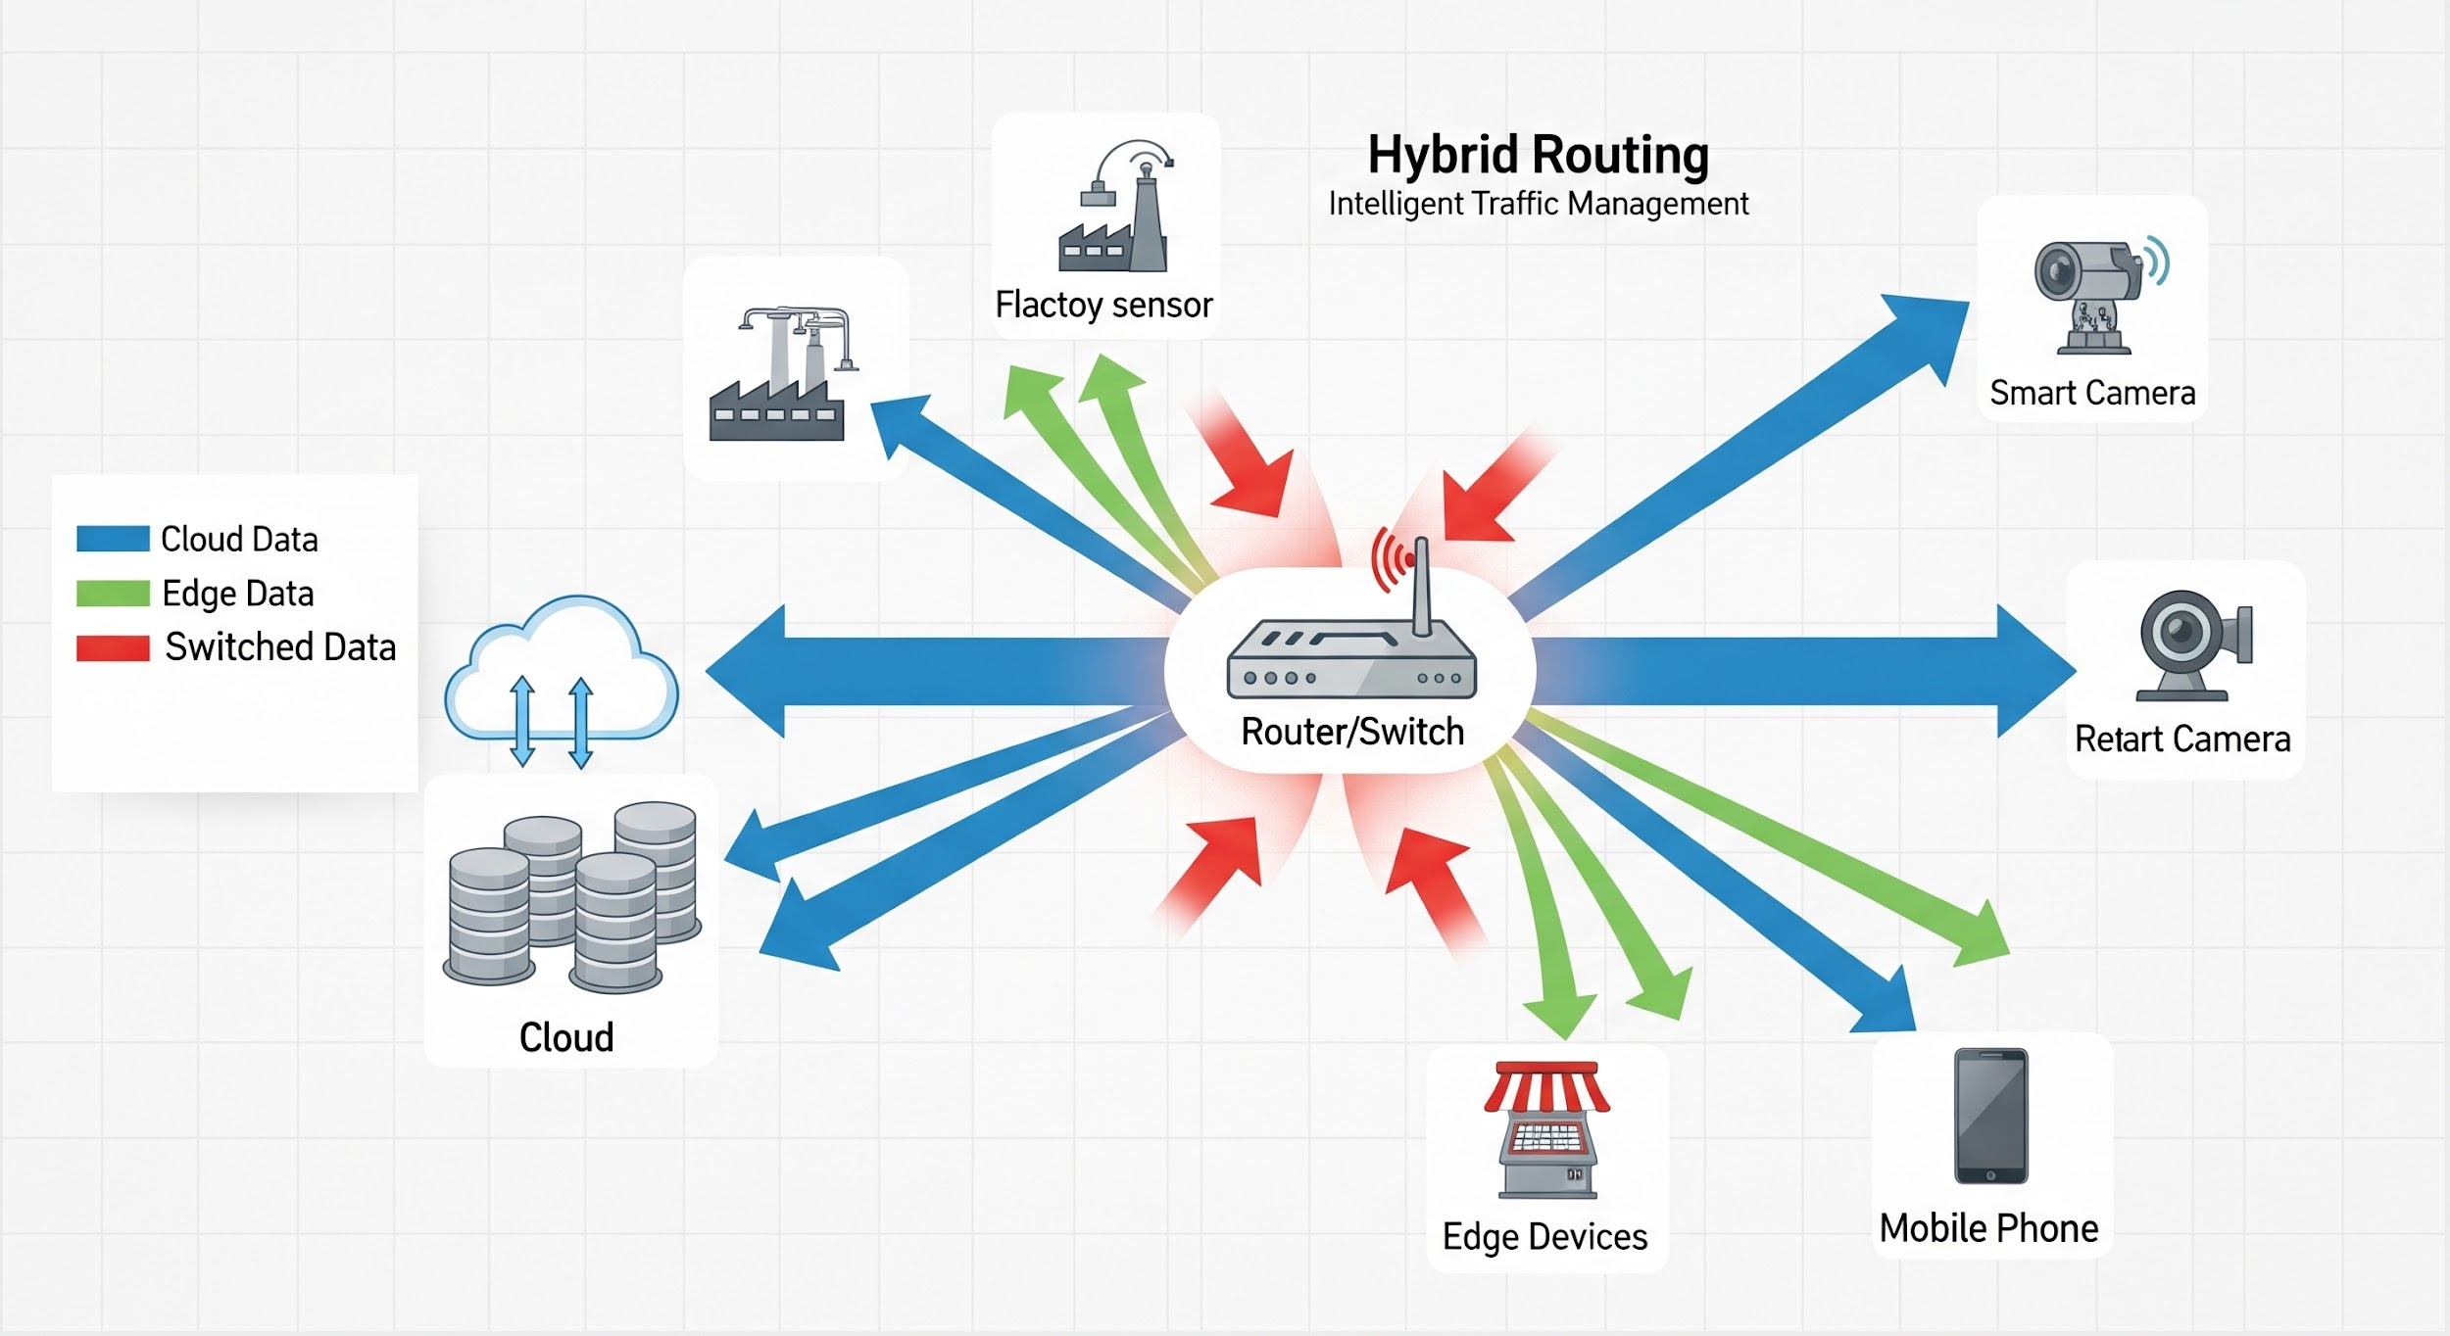
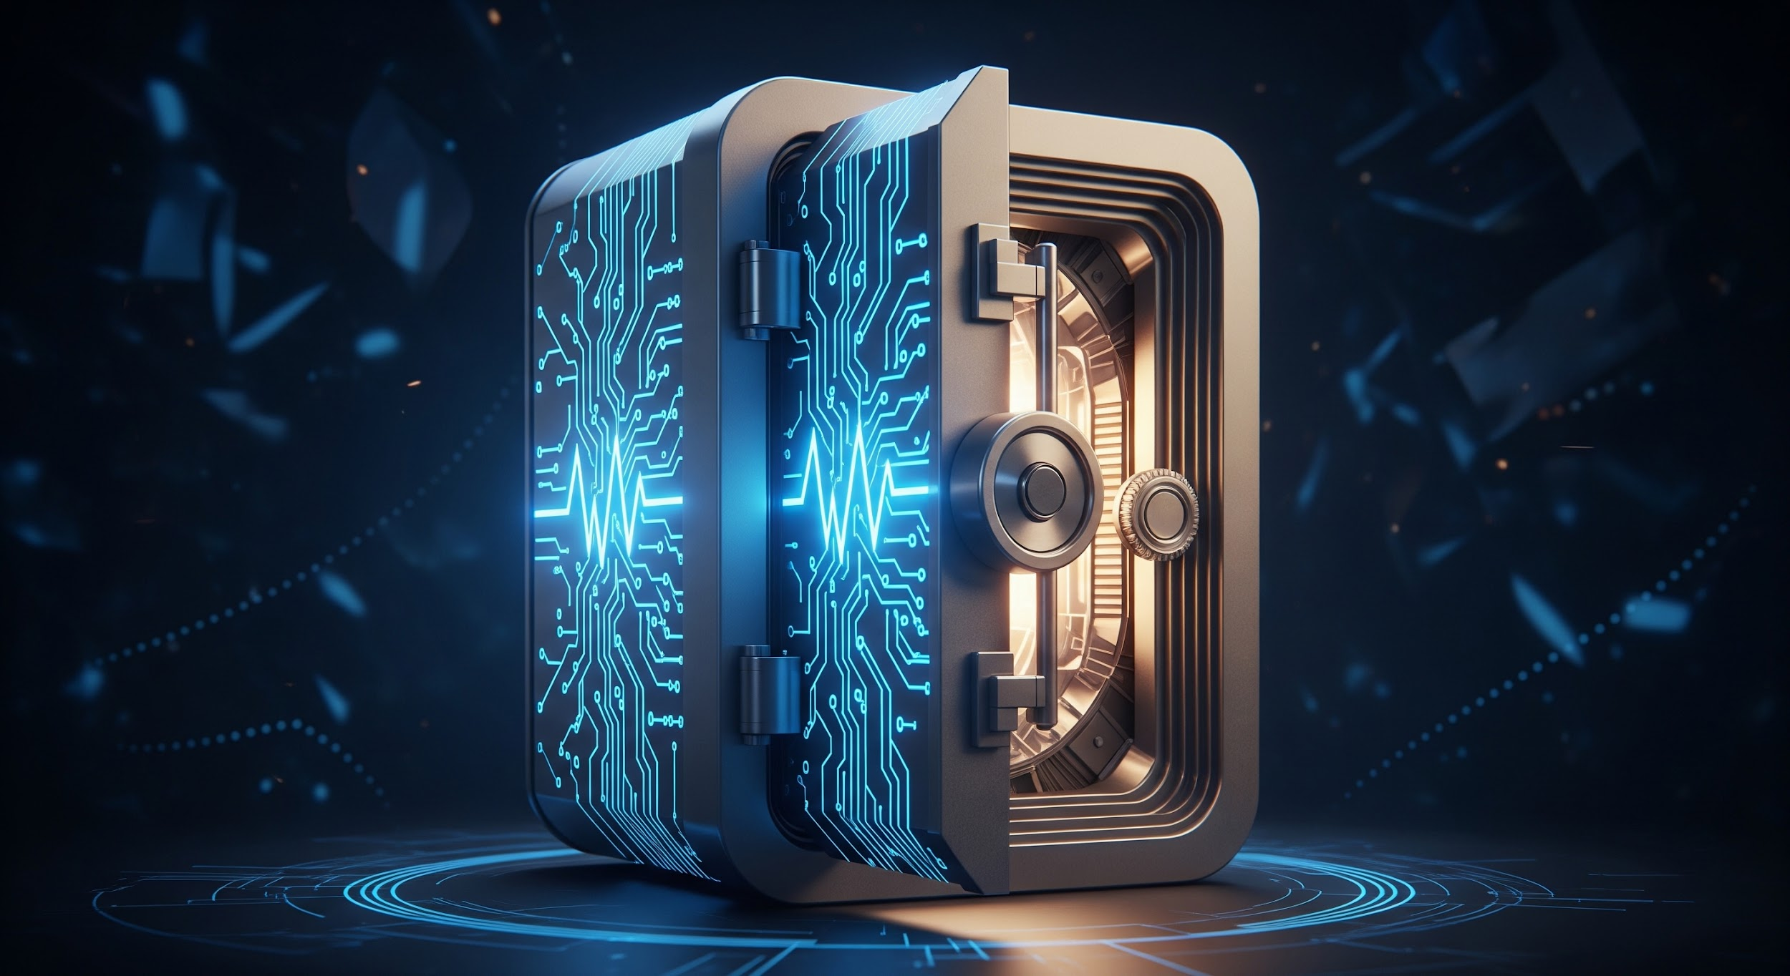
Mission Accomplished
DocuMind AI provides a scalable, secure, and hybrid future for document interaction.
RAG Integration
Hybrid Routing
Privacy-First
Successful implementation of high-fidelity retrieval systems.
Functional intelligent switching between local and cloud compute.
Architecture designed for maximum data sovereignty and security.

Slide 31
Q & A
Thank you for your time!
DocuMind AI: Hybrid RAG Knowledge Assistant

